Slide 1



CDL TOKEN
Crypto Data live
INTIAL COIN OFFERING
Presented by CDL team,
GET STARTED
Date: 26, Nov 2024

Slide 2
Table of content
CDL TOKEN INTRODUCTION 03
ABOUT US CDL TOKEN 04
CDL TOKEN STRATEGIES 05
CDL TOKEN ECOSYSTEM 06
ROADMAP & MILESTONE 12
OUR TEAM AND PARTNERS 21/22
This table of contents provides a basic outline of the contents of the whitepaper, focusing on the essential aspects of the crypto data live.

Slide 3
Introduction
Company Overview
01
02
CDL Token is the native cryptocurrency of Crypto.Data.Live, a trailblazing platform revolutionizing the crypto space with institutional-grade data, analytics, and real-time news.
Designed to bridge the gap between professional trading tools and individual traders, CDL Token is your key to smarter decisions and a competitive edge in the dynamic crypto market.
03
04
Focused on delivering institutional-grade data, advanced analytics, and reliable news, Crypto.Data.Live empowers individuals and institutions to make informed decisions in an ever-evolving financial landscape
Crypto.Data.Live is a cutting-edge platform dedicated to revolutionizing the way traders and investors interact with the cryptocurrency market.

Slide 4

About us
At Crypto.Data.Live, we are revolutionizing the cryptocurrency trading landscape by delivering institutional-grade data, analytics, and real-time insights to a global audience. Our mission is to democratize access to advanced trading tools, empowering both individual traders and institutions to thrive in the fast-paced world of digital assets.
Innovation, precision, and community are at the heart of what we do.
Our platform combines the latest advancements in artificial intelligence, blockchain technology, and smart contract automation to provide a seamless, data-driven experience. With our native CDL Token, we bridge the gap between institutional trading tools and individual traders, offering cutting-edge solutions that enhance decision-making, optimize strategies, and unlock new opportunities in decentralized finance.

Slide 5

OUR VISION
To revolutionize the cryptocurrency trading landscape by providing traders and investors with cutting-edge tools, data, and technology, empowering them to make smarter, informed decisions in a decentralized financial world. We envision a future where all participants, from individuals to institutions, have equal access to the insights and tools necessary to succeed in the evolving crypto market.

Slide 6

OUR MISSION
Our mission is to bridge the gap between institutional-grade trading tools and individual traders by offering real-time market data, AI-driven analytics, and seamless integration with decentralized platforms. We aim to foster a user-centric ecosystem that empowers crypto enthusiasts with the tools, knowledge, and governance capabilities to shape their financial futures and thrive in the decentralized economy.

Slide 7



CDL TOKEN STRATEGIES
Leverage Real-Time Data and AI Tools
Smart Decision-Making: Utilize CDL Token to unlock access to institutional-grade data, market analytics, and predictive AI tools. These insights enable informed trading strategies and portfolio optimization.
Reduce Transaction Costs with Smart Contracts
Lower Gas Fees: Leverage CDL’s smart contract automation to optimize transactions and minimize gas costs. This is particularly beneficial for frequent traders or users of decentralized applications (dApps).
Integrate with Web3 Ecosystems
Seamless API Integration: Use CDL Token for API connectivity with decentralized applications, making it easier to build and interact with Web3 platforms.

Slide 8


CDL TOKEN ECOSYSTEM
The CDL Token is the cornerstone of the Crypto.Data.Live ecosystem, a cutting-edge platform designed to empower traders and investors with advanced tools, data insights, and seamless integration into the decentralized economy. The CDL Token unlocks a suite of services and features, enabling users to navigate the crypto market with confidence, precision, and agility
Real-Time Data: Market insights and predictive tools for smarter trading.
AI Analytics: Optimize portfolios with advanced AI tools.
DeFi Tools: Stake, lend, and transact with low gas fees.
Web3 Integration: Seamless API and dApp connectivity.
Governance: Vote on platform decisions and earn rewards.
Cross-Platform Access: Use on web, mobile, and APIs.
Innovation: Future-ready roadmap with advanced features.

Slide 9




Our services
Real-Time Market Data & Insights
AI-Driven Analytics
DeFi Solutions
Web3 Integration
Access live, verified market data, predictive pricing, and tailored alerts to make informed trading decisions
Optimize your portfolio with AI-powered tools that provide predictive insights, risk assessments, and market forecasts
Engage in decentralized finance with staking, lending, and low-cost transactions powered by smart contract automation
Seamlessly integrate APIs for dApps and decentralized platforms to enhance your trading experience across Web3 ecosystems

Slide 10
Access to Institutional-Grade Tools: Gain advanced market data, AI-driven analytics, and predictive insights typically reserved for large institutions.
01
02
DeFi Participation: Stake, lend, and engage in decentralized finance with low gas fees and smart contract automation for efficient transactions.
CDL Token Benefits
03
Governance & Rewards: Participate in platform decisions through staking and vote on future developments, earning rewards for your contributions
04
Cross-Platform Integration: Seamlessly use CDL Token across web, mobile apps, APIs, and smart contracts for an optimized trading experience.

Slide 11


















HOW TO GET STARTED
Earn Daily Profits
Buy CDL Token
Launch Dapp
Deposit Coin
Stake CDL Token
Trade on Cex’s & Dex’s

Slide 12





CDL TOKEN ROADMAP
Q4 2024: Foundation & Initial Development
Q2 2025: Expansion & Governance Features
Q5 Cex’s & Dex’s Listing
Ongoing & Future Features
Q1 2025: Platform Development & Token Utility Expansion
Q3 2025: Global Outreach & Ecosystem Growth

Slide 13
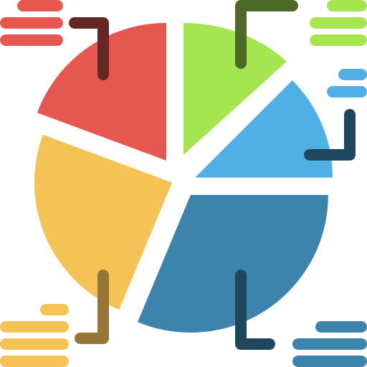
Tokenomics
CDL TOKEN VESTING & ALLOCATION
Allocation:
Community & Ecosystem (40%) – For liquidity, staking, and ecosystem growth.
Team & Advisors (20%) – Motivates the development team and advisors.
Presale & Public Sale (25%) – Tokens sold to early investors at a discounted price.
Reserve Fund (10%) – For unforeseen needs and future liquidity.
Partnerships & Ecosystem Development (5%) – For strategic partnerships.
Vesting Schedule:
Team & Advisors: 24-month vesting, 6-month cliff.
Presale & Public Sale: 12-month vesting, 3-month cliff.
Community & Ecosystem: Ongoing distribution based on engagement.
Partnerships: 12-month vesting, milestone-based unlocking.
Unlocking Schedule:
Initial Unlock: Post-presale release for liquidity.
Ongoing Unlock: Tokens progressively unlocked over time for sustained growth

Slide 14
CDL TOKEN TECNOLOGY
DeFi Capabilities:
CDL Token supports decentralized finance (DeFi) applications, enabling staking, lending, and liquidity mining with reduced gas costs and enhanced smart contract automation.
CDL Token is built on a secure, scalable blockchain, ensuring fast and transparent transactions with low fees. The token leverages smart contracts to automate processes, enhancing efficiency and security
Web3 and API Connectivity:
CDL Token offers seamless integration with Web3 and decentralized applications (dApps), making it easy for users to access features through APIs and various platforms.
Governance Mechanism:
Token holders can participate in the decision-making process, voting on key updates and project developments, ensuring community-driven growth and a decentralized approach.

Slide 15







CDL Token: AI-Driven Tools
The CDL Token ecosystem leverages advanced AI-powered tools to provide traders with predictive analytics and portfolio optimization features. These cutting-edge solutions empower users to make smarter, data-driven decisions and enhance their trading strategies with precision and efficiency
Real-Time Market Insights
Portfolio Optimization
Predictive Analytics
Automated Recommendations
Predictive analytics for proactive support
30%
70%
Introduction to Predictive Analytics
Benefits of Predictive Analytics for Proactive Support

Slide 16



Thynk Unlimited
CDL TOKEN SECURITY
Prioritizing Security for Ecosystem
At CDL Token, security is at the core of our platform’s design. We are committed to safeguarding user assets, data, and transactions through robust security measures and state-of-the-art technologies. By implementing advanced practices, we ensure a secure and reliable trading environment for all users.
Date
CDL Token's security framework is designed to provide a robust, transparent, and trustworthy platform. By prioritizing safety and integrity, we empower users to focus on trading and investing with confidence, knowing their assets and data are protected.

Slide 17
Risks and Solutions
01
Market Volatility
Risk: Price fluctuations in the crypto market.
Solution: Real-time data, AI-driven analytics, and portfolio optimization to help users navigate market changes.
02
Regulatory Uncertainty
Risk: Evolving regulations affecting crypto operations.
Solution: Focus on compliance and adaptable governance to stay aligned with regulatory requirements.
03
Security Risks
Risk: Potential cyberattacks or data breaches.
Solution: Regular smart contract audits, secure Web3 integration, and encryption to protect user data and funds.
04
Scalability Challenges
Risk: Increased demand could impact platform performance.
Solution: Smart contract automation and continuous innovation to optimize scalability.
05
Competition
Risk: Competition from established crypto data platforms.
Solution: Offer institutional-grade insights, AI-powered tools, and cross-platform accessibility to stand out.

Slide 18

CDL TOKEN DAPP
The CDL Token DApp is a cutting-edge decentralized application designed to provide users with powerful tools for trading and investing in the crypto space. Built on the Ethereum and BNB blockchains, the CDL Token DApp offers a wide range of features including real-time data feeds, AI-driven analytics, smart contract automation, and decentralized governance. This platform empowers users to make informed decisions, optimize portfolios, and engage in the growing world of decentralized finance (DeFi) with transparency and securit
CDL Token DApp bridges the gap between individual traders and institutional-grade financial tools. Whether you’re a novice or experienced trader, the CDL Token DApp provides accessible and innovative solutions to enhance your trading strategies. With features like data analytics, AI-powered insights, and staking rewards, the CDL Token DApp is poised to redefine the future of crypto trading.

Slide 19

Pioneering the Future of Crypto Trading and Innovation
Empowering the Future of Crypto Trading with CDL Token: Where Innovation Fuels Success.

Slide 20


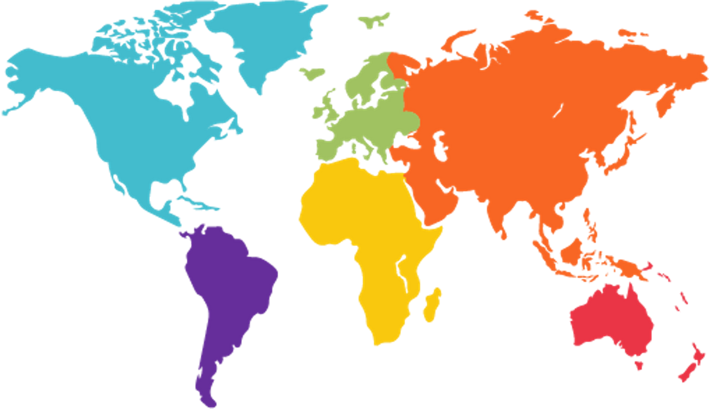

CDL Token
Headquarters
CDL Token is headquartered in the financial heart of London, a global hub for innovation, technology, and finance. This strategic location places CDL Token at the epicenter of the world’s leading crypto and blockchain advancements, fostering collaboration with top-tier institutions and a vibrant community of blockchain enthusiasts.
From our London base, we drive the development of cutting-edge tools and solutions, ensuring CDL Token remains at the forefront of decentralized finance (DeFi). With a commitment to transparency, security, and innovation, our headquarters serves as the command center for delivering exceptional value to our users and partners worldwide.
"At the crossroads of tradition and innovation, CDL Token shapes the future of global crypto trading from London."
UK

Slide 21








Our Partners

Slide 22




Meet Our Team
Jason Shubrook
Stephen Freshwater
Brian Fudge
Andrew Speer
Co-Founder & CEO
Co-Founder & COO
Co-Founder & CFO
CMO

Slide 23



Get in Touch
Contact Us
Thank you for your interest in CDL Token. If you have any inquiries or require Further information, please feel free to reach out to us at.
Jason Shubrook
Co-Founder & CEO
+44 7970 067791
jason@cryptodata.live
www.cryptodata.live

Slide 24


Thank You
CDL Token Team

